Slide 1
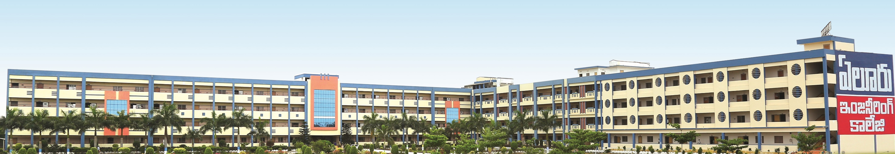

Eluru College of Engineering and Technology
ELURU COLLEGE OF ENGINEERING AND TECHNOLOGY
Department of
Department of
Electronics and communication engineering
ULTRASONIC BASED MEASUREMENT SYSTEM FOR LIQUID LEVEL AND TYPE MONITORING
Presented by:
M. G. Deepak Sai kumar 19JD1A0440
B. B. S. Krishna Vamsi 20JD5A0401
A. Vamsi Krishna 19JD1A0401
Under the guidance of
P.Suryanarayana
Assistant professor
Dept. of ECE

Slide 2
Contents
Introduction
Existing system and its drawbacks
Proposed system and its advantages
Hardware and Software used
Results
Applications
References

Slide 3







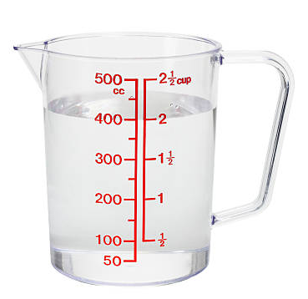
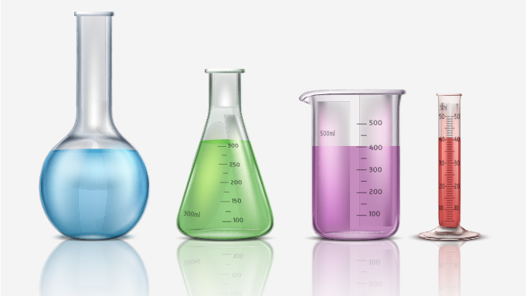




Introduction
The problem we discovered is the measuring of liquids we use in our daily life basis – for example, Drinking water, or any other liquids like oils, fuel etc.
Traditional method of measuring liquid is simply pouring the liquid into a measuring jar which will have some markings, based on the level and the mark it reached, we will find the volume of the liquid.
Fig: A measuring cup
Fig: Various types of volume measuring instruments

Slide 4
Modern problems require modern solutions
As we are living in the era of technological advancements, we have to use technology to make our lives easy
This intro can become more interesting with a basic question “Why we should measure the volume of the liquid…??”. The answer is, We should be aware of the level of consumption when it comes to the aspect of systematic usage.
We can also make a device to measure the volume of liquid in the container with the help of electronics.
The construction of a device for the measurement of liquid level in a container would make a possible change in the measuring of liquids.

Slide 5

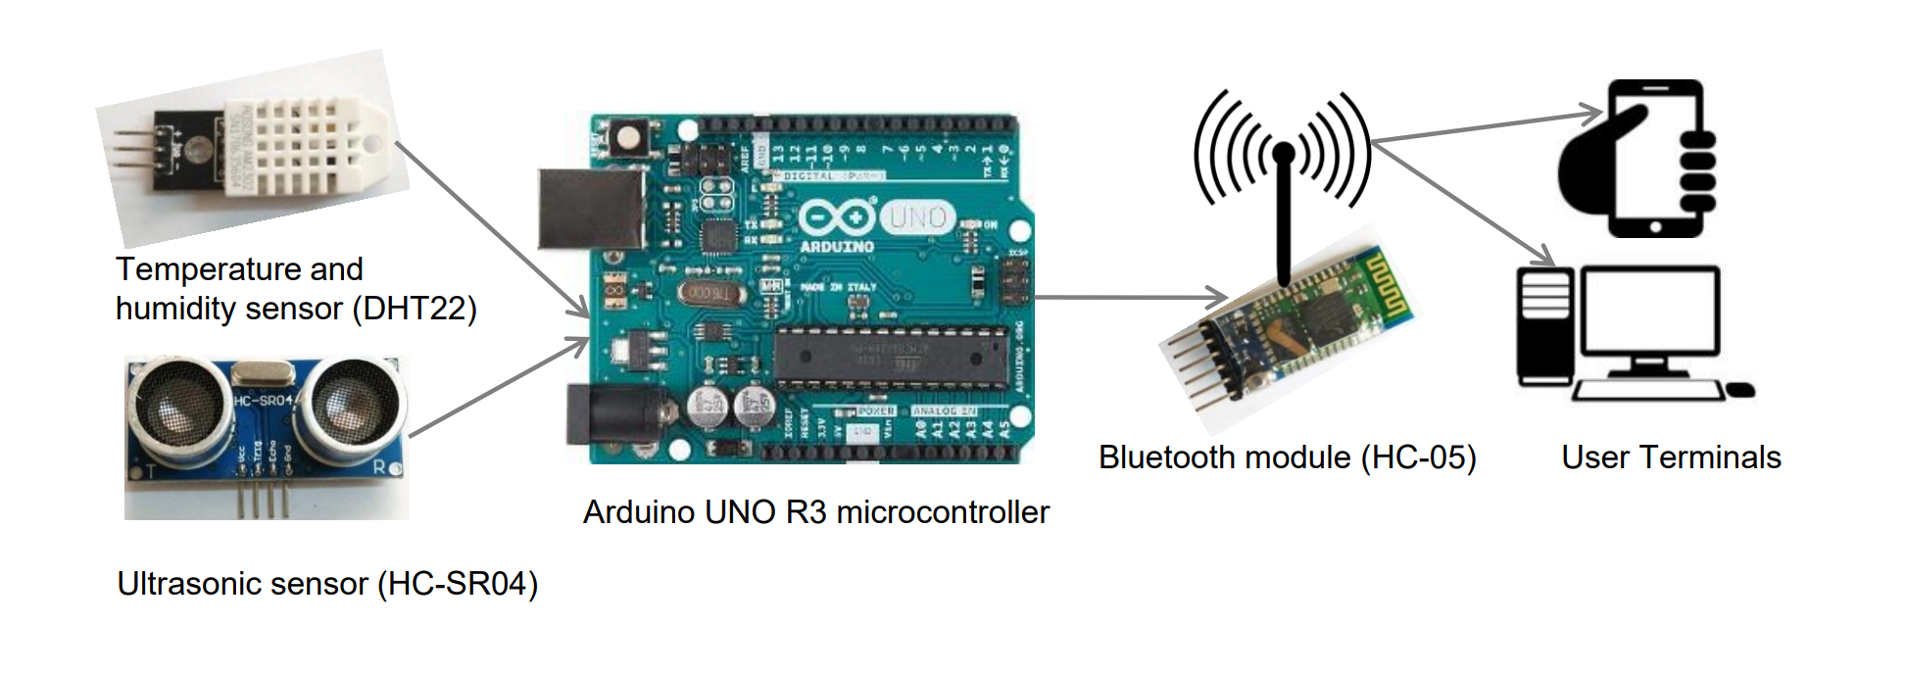
Construction of existing system:

Slide 6
The data from the ultrasonic sensor, temperature sensor, humidity sensor, computed speed of sound and measured distance for different water levels were taken and logged to the machine through communication module (HC-05) for analysis.
Measured distance or ultrasonic distance was computed using ToF and speed of sound.
The UMS was installed on container at top center position with the ultrasonic transducers facing downwards, perpendicular to the water surface.
This method could limit the error to 0.5 mm over a distance range up to 500 mm.

Slide 7
Disadvantages of existing system:
This method is just a basic construction of the system.
Limited to Bluetooth connectivity.
Data maintenance system is not implemented.
Doesn’t care about the position of the container.
This method could limit the error to 0.5 mm over a distance range up to 500 mm.

Slide 8
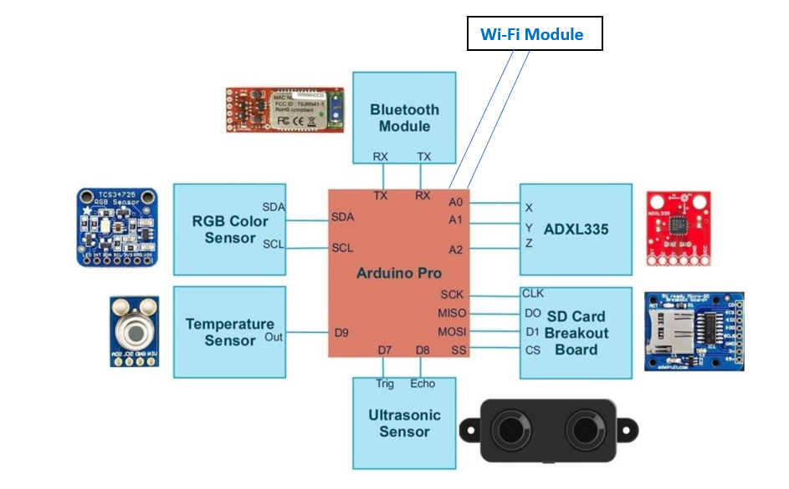
Proposed system :

Slide 9
Advantages of proposed system:
Our proposed method has two advantages:
First, by integrating the problem of finding the shared embedding space and the classification problem, we need to solve only one optimization problem, and this reduces the complexity of our system.
Considering the position of the container, we can remove errors in the calculating the volume

Slide 10
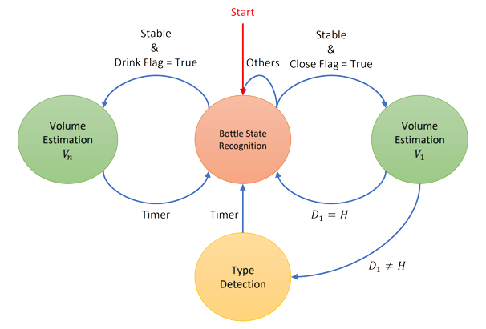
State diagram of the system:

Slide 11
Hardware used:
Arduino Nano
Waterproof Ultrasonic sensor - A02YYUW
RGB color sensor - TCS3200
Temperature sensor - DS18B20
Accelerometer sensor - ADXL335
Bluetooth module - HC05
SD card breakout board
Software used:
Arduino IDE

Slide 12
Results:
We can expect the accuracy of fluid type detection ranges from 74.93% to 94.98% while trying to detect the fluid of an unseen bottle.
The Data storing system can be used to plot and monitor various types of interpretations, so that we can monitor things .
The color sensor can be used to monitor types of liquid so that, in future we can estimate and predict things faster than present and past.
The power consumption of this system is very low, which can be classified as a power efficient device

Slide 13
Applications:
The concentrated development of this project is limited to a water bottle, still we can make some changes so that this device can be used in different environments.
The futuristic development of this device is to embed this to a saline bottle, so that the doctor or nurse can use to monitor/control the flow of infusion liquids to a patient
Another area of application is at industries where they work with many liquids that has to be mixed so precisely.

Slide 14
Conclusion
We designed, developed, and evaluated a low-power and portable sensor system for detecting fluid type and volume using low-cost, commercially available sensors including accelerometer, RGB, ultrasonic and temperature sensors which cost less than $50. We have implemented feature engineering and machine learning algorithms to process raw sensor data to detect fluid volume.

Slide 15
References:
[1] M. Pedram et al., "LIDS: Mobile System to Monitor Type and Volume of Liquid Intake," inIEEE Sensors Journal, vol. 21, no. 18, pp. 20750-20763, 15 Sept.15, 2021, doi: 10.1109/JSEN.2021.3081012.
[2] A. K. Sahoo and S. K. Udgata, "A Novel ANN-Based Adaptive Ultrasonic Measurement System for Accurate Water Level Monitoring," in IEEE Transactions on Instrumentation and Measurement, vol. 69, no. 6, pp. 3359-3369, June 2020, doi: 10.1109/TIM.2019.2939932.

Slide 16

Thank you

